Slide 1
Getting Started with NumPy
Setting the scene
NumPy arrays
Manipulating array elements
Manipulating array shape

Slide 2
Section 1: Setting the Scene
Overview
Python libraries for data science
Getting the data science libraries
Aside: Online Python environment

Slide 3
Overview
Python is a popular choice for data science and machine learning
Attractive characteristics of Python:
Dynamic language, so it's good for rapid exploratory coding
Relatively simple syntax, so it's easier to become proficient
Popular in schools and universities, so the skills are available

Slide 4
Python Libraries for Data Science
NumPy is a numeric processing API for Python
Fast mathematical computation of numeric arrays and matrices
Pandas provides additional features based on NumPy
Additional support for indexing, reading/writing CSV/Excel, etc.
MatPlotLib is a graphical plotting API for Python
Similar to Matlab, allows you to plot graphs, charts, etc.
Scikit-Learn is a machine learning library for Python
Implements many supervised/unsupervised learning algorithms

Slide 5
Getting the Data Science Libraries
If you're using a standalone Python distribution, you must download the data science libraries using pip:
Note: if you're using Anaconda, the data science libraries are already downloaded for you
In your Anaconda installation folder, see Lib/site-packages
pip install numpy
pip install openpyxl
pip install xlrd
pip install matplotlib
pip install pandas
pip install seaborn
pip install cython
pip install scikit-learn

Slide 6
Aside: Online Python Environment
If you don't have Python installed, or if you're unable to install the data science libraries atm…
You can use an online Python environment such as:
https://www.online-python.com/

Slide 7
Section 2: NumPy Arrays
Getting started with NumPy arrays
Techniques for creating NumPy arrays
Reading CSV data
Visualizing data

Slide 8
Getting Started with NumPy Arrays (1 of 2)
NumPy holds data in N-dimensional arrays
An array is an instance of the numpy.ndarray class
All the data in a NumPy array is the same type
This allows NumPy to store and process the data efficiently
Why are NumPy arrays more efficient than Python lists?
Python is dynamically typed, so every object contains metadata that identifies the type at run time
In a Python list, every item contains this metadata - eek!
In a NumPy array, only the array itself contains the metadata

Slide 9
Getting Started with NumPy Arrays (2 of 2)
This example creates a NumPy array from a Python list
Gets the shape of the array, via the shape property
Gets the data type of array elements, via the dtype property
(Note: We won't show the import numpy statement in the rest of the code samples in this chapter)
# Import the NumPy module.
import numpy as np
# Create a 1D NumPy array from a Python list.
a = np.array([1, 2, 3])
print('Data values in a\n', a)
print('Shape of a:', a.shape)
print('Data type in a:', a.dtype)
# Create a 2D NumPy array from a Python list of lists.
b = np.array([[1, 2, 3], [4, 5, 6]])
print('\nData values in b\n', b)
print('Shape of b:', b.shape)
print('Data type in b:', b.dtype)
Ex01-GettingStartedWithArrays.py

Slide 10
Techniques for Creating NumPy Arrays (1 of 2)
# Create array with mixed types - NumPy converts element types "upwards".
a = np.array([1, 2, 3.14])
# Create array with a specified type.
b = np.array([1, 2, 3], dtype='float64')
# Create array from a numeric range.
c = np.arange(0, 20, 2)
# Create array of elements, linear spaced.
d = np.linspace(0.0, 1.0, 11)
# Create array of zeros.
# You can specify a tuple of dimensions too, e.g. np.zeros((2,3)).
e = np.zeros(5)
# Create array of ones.
f = np.ones(5)
# Create array of elements, with specified value.
g = np.full(5, 1.23)
# Create array of elements, no specified value.
h = np.empty(5)
Ex02-CreateArrays.py

Slide 11
Techniques for Creating NumPy Arrays (2 of 2)
You can also create random arrays, which can be handy
# Create 10 random values in range [0.0, 1.0).
a = np.random.random(10)
# Create 10 normally-distributed random values.
b = np.random.normal(5, 2, 10)
# Create 10 random integers in range [0, 101).
c = np.random.randint(0, 101, 10)
Ex03-CreateRandomArrays.py

Slide 12
Reading CSV Data
A common requirement is to read data from a CSV file
The easiest way is via the Pandas read_csv() function
Pandas reads values into a multi-column DataFrame
You can then extract a column into a NumPy array
We'll discuss Pandas in detail later …
import numpy as np
import pandas as pd
# Read a csv file, get a Pandas DataFrame back.
dataframe = pd.read_csv('WorldCupWinners.csv')
# Get the 'Team' column.
teams = np.array(dataframe['Team'])
print(teams)
Ex04-ReadFromCsv.py

Slide 13
Visualizing Data (1 of 2)
Visualization is an important aid to help you understand the shape and meaning of data
You can use the MatPlotLib library to visualize data in lots of different ways
Line graphs
Scatter graphs
Bar-charts
Pie-charts
Histograms
Etc.

Slide 14
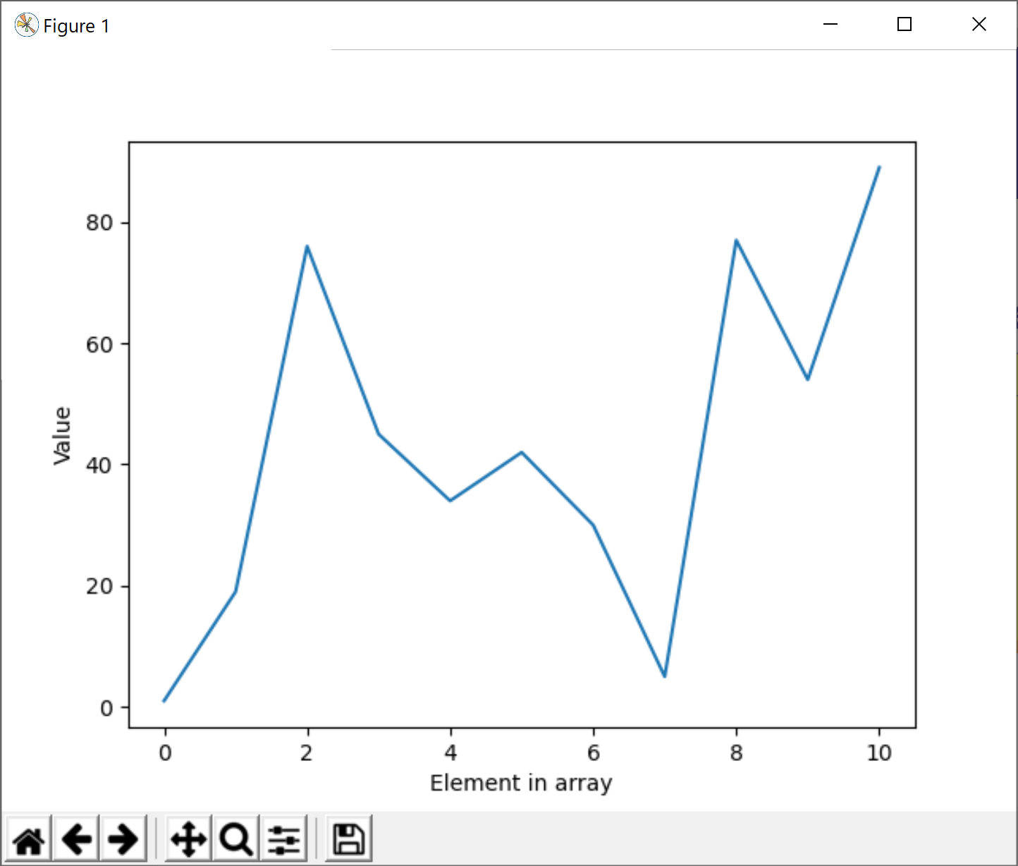
Visualizing Data (2 of 2)
Here's a simple example of how to visualize data using MatPlotLib - we'll see more plotting features later
To save an image:
import numpy as np
import matplotlib.pyplot as plt
data = np.array([1, 19, 76, 45, 34, 42, 30, 5, 77, 54, 89])
plt.xlabel('Element in array')
plt.ylabel('Value')
plt.plot(data)
plt.show()
Ex05a-VisualizeData.py
plt.savefig('data.jpg')
Ex05b-VisualizeData.py

Slide 15
Section 3: Manipulating Array Elements
Indexing into an array
Slicing an array
Accessing a specific column or row
Aside: Views vs. copies

Slide 16
Indexing into an Array
Indexing into a NumPy array is quite intuitive:
# Create a 1D array, index into it, and modify elements.
a = np.array([0, 10, 20, 30, 40, 50, 60, 70])
print(a)
print(a[1]) # 10 (zero-based index starts from front)
print(a[-1]) # 70 (negative-based index starts from end)
a[1] = 111
print(a)
# Create a 2D array, index into it, and modify elements.
b = np.array([[0, 10, 20, 30], [40, 50, 60, 70]])
print(b)
print(b[0, 1]) # 10 ([r,c] indexes into 2D array)
print(b[0, -1]) # 30
print(b[-1, 1]) # 50
print(b[-1, -1]) # 70
b[0, 1] = 111
print(b)
0 | 10 | 20 | 30 | 40 | 50 | 60 | 70
0 | 10 | 20 | 30
40 | 50 | 60 | 70
Ex06-IndexIntoArrays.py

Slide 17
Slicing an Array
You can slice into an array using a [start:stop:step] index
start Default start is 0
stop Default stop is the size of the dimension
step Default step is 1
# Get slices into 1D array.
a = np.array([0, 10, 20, 30, 40, 50, 60, 70, 80])
print(a[3:]) # [30 40 50 60 70 80]
print(a[:3]) # [ 0 10 20]
print(a[3:7]) # [30 40 50 60]
print(a[3:7:2]) # [30 50]
print(a[3::2]) # [30 50 70]
print(a[::2]) # [ 0 20 40 60 80]
# Get slices into 2D array.
b = np.array([[0, 10, 20], [30, 40, 50], [60, 70, 80]])
print(b[1:, 1:]) # [ [40 50] [70 80] ]
print(b[:2, :2]) # [ [ 0 10] [30 40] ]
print(b[::2, ::2]) # [ [ 0 20] [60 80] ]
0 | 10 | 20 | 30 | 40 | 50 | 60 | 70 | 80
0 | 10 | 20
30 | 40 | 50
60 | 70 | 80
Ex07-Slices.py

Slide 18
Accessing a Specific Column or Row
To get a specific column or row in a multidimension array:
Use an empty slice to skip a dimension
E.g. in a 2D array, [:,1] gets column 1
E.g. in a 2D array, [1,:] gets row 1
a = np.array([[0, 10, 20], [30, 40, 50], [60, 70, 80]])
# To access a specific column...
print(a[:, 0]) # [ 0 30 60]
print(a[:, 1]) # [10 40 70]
print(a[:, 2]) # [20 50 80]
# To access a specific row...
print(a[0, :]) # [ 0 10 20]
print(a[1, :]) # [30 40 50]
print(a[2, :]) # [60 70 80]
# To access a specific row, simpler syntax...
print(a[0]) # [ 0 10 20]
print(a[1]) # [30 40 50]
print(a[2]) # [60 70 80]
0 | 10 | 20
30 | 40 | 50
60 | 70 | 80
Ex08-AccessColumnOrRow.py

Slide 19
Aside: Views vs. Copies
When you get an array slice/row/column, you get a data view
If you make any changes, it will change the actual data
If you want to get a data copy:
Call copy() on the slice/row/column
a = np.array([[0, 10, 20], [30, 40, 50], [60, 70, 80]])
col0View = a[:, 0]
col0View[2] = 600
print(col0View)
print(a) # [[ 0 10 20] [ 30 40 50] [600 70 80]]
0 | 10 | 20
30 | 40 | 50
60 | 70 | 80
Ex09a-Views.py
b = np.array([[0, 10, 20], [30, 40, 50], [60, 70, 80]])
col0Copy = b[:, 0].copy()
col0Copy[2] = 600
print(col0Copy)
print(b) # [[ 0 10 20] [ 30 40 50] [60 70 80]]
0 | 10 | 20
30 | 40 | 50
60 | 70 | 80
0 | 30 | 60
Ex09b-Copies.py

Slide 20
Section 4: Manipulating Array Shape
Reshaping an array
Creating new axes
Concatenating arrays
Stacking arrays vertically or horizontally
Splitting an array

Slide 21
Reshaping an Array
Reshaping is a common way to create a multi-dim array
Create a 1D array initially (typically)
Reshape it to a multi-dim array (must be compatible shape)
The multi-dim array is a view onto the original 1D array
# Create 1D array initially, for simplicity.
a = np.arange(9)
print(a) # [0 1 2 3 4 5 6 7 8]
print(a.shape) # (9,)
# Reshape as 2D array (view on a).
b = a.reshape((3,3))
print(b) # [[0 1 2] [3 4 5] [6 7 8]]
print(b.shape) # (3, 3)
# Changing items in b will change values in underlying a.
b[0,0] = 99
print(a) # [99 1 2 3 4 5 6 7 8]
print(b) # [[99 1 2] [ 3 4 5] [ 6 7 8]]
0 | 1 | 2 | 3 | 4 | 5 | 6 | 7 | 8
Ex10-ReshapeArray.py

Slide 22
Creating New Axes
Another useful technique is create new axes for an array
Create a 1D array initially (typically)
Create a new column or row, using np.newaxis
# Create 1D array initially, for simplicity.
a = np.arange(5)
print(a) # [0 1 2 3 4]
print(a.shape) # (5,)
# Create 2D array with 1 row, 5 columns.
b = a[np.newaxis, :]
print(b) # [[0 1 2 3 4]]
print(b.shape) # (1, 5)
# Create 2D array with 5 rows, 1 column.
c = a[:, np.newaxis]
print(c) # [[0] [1] [2] [3] [4]]
print(c.shape) # (5, 1)
a
0 | 1 | 2 | 3 | 4
b
0 | 1 | 2 | 3 | 4
c
0
1
2
3
4
Ex11-NewAxis.py

Slide 23
Concatenating Arrays (1 of 2)
You can concatenate same-size arrays together
np.concatenate() - you can specify the axis to concatenate on
Here's a simple example that concatenates 1D arrays
# Create some 1D arrays.
a = np.array([ 0, 1])
b = np.array([10, 11])
c = np.array([20, 21])
# Concatenate the 1D arrays.
result = np.concatenate([a, b, c])
print(result) # [0 1 10 11 20 21]
print(result.shape) # (6,)
a
b
c
0 | 1
10 | 11
20 | 21
0 | 1 | 10 | 11 | 20 | 21
Ex12a-ConcatenateArrays.py

Slide 24
Concatenating Arrays (2 of 2)
Here's an example that concatenates 2D arrays
Note the optional axis parameter (default is 0)
a
b
c
# Create some 2D arrays.
a = np.array([[ 0, 1], [10, 11]])
b = np.array([[20, 21], [30, 31]])
c = np.array([[40, 41], [50, 51]])
# Concatenate on axis 0 (this is the default, so can omit axis parameter).
result1 = np.concatenate([a, b, c], axis=0)
print(result1) # [[0 1] [10 11] [20 21] [30 31] [40 41] [50 51]]
print(result1.shape) # (6, 2)
# Concatenate on axis 1.
result2 = np.concatenate([a, b, c], axis=1)
print(result2) # [[0 1 20 21 40 41] [10 11 30 31 50 51]]
print(result2.shape) # (2, 6)
0 | 1
10 | 11
20 | 21
30 | 31
40 | 41
50 | 51
Ex12b-ConcatenateArrays.py

Slide 25
Stacking Arrays Vertically or Horizontally
You can stack different-size arrays together
np.vstack() - stack vertically (must have same no. of cols)
np.hstack() - stack horizontally (must have same no. of rows)
a = np.array([10, 11])
b = np.array([[20, 21], [30, 31]])
result1 = np.vstack([a, b])
print(result1) # [[10 11] [20 21] [30 31]]
print(result1.shape) # (3, 2)
a
10 | 11
b
20 | 21
30 | 31
Ex13a-VStack.py
c = np.array([[40, 41], [50, 51]])
d = np.array([[60], [61]])
result2 = np.hstack([c, d])
print(result2) # [[40 41 60] [50 51 61]]
print(result2.shape) # (2, 3)
c
d
40 | 41
50 | 51
60
61
Ex13b-HStack.py

Slide 26
Splitting an Array
You can split an array into subarrays
np.split(), np.vsplit(), np.hsplit()
# Split a 1D array.
a = np.arange(16)
a1, a2, a3, a4 = np.split(a, [2, 5, 9])
print('\na1\n', a1) # [0 1]
print('\na2\n', a2) # [2 3 4]
print('\na3\n', a3) # [5 6 7 8]
print('\na4\n', a4) # [9 10 11 12 13 14 15]
# Split a 2D vertically.
b = np.arange(16).reshape((4, 4))
b1, b2 = np.vsplit(b, [3])
print('\ntop\n', b1) # [[0 1 2 3] [4 5 6 7] [8 9 10 11]]
print('\nbottom\n', b2) # [[12 13 14 15]]
# Split a 2D horizontally.
c = np.arange(16).reshape((4, 4))
c1, c2 = np.hsplit(c, [3])
print('\nleft\n', c1) # [[0 1 2] [4 5 6] [8 9 10] [12 13 14]]
print('\nright\n', c2) # [[3] [7] [11] [15]]
Ex14-SplitArray.py

Slide 27
Summary
Setting the scene
NumPy arrays
Manipulating array elements
Manipulating array shape

